Slide 1
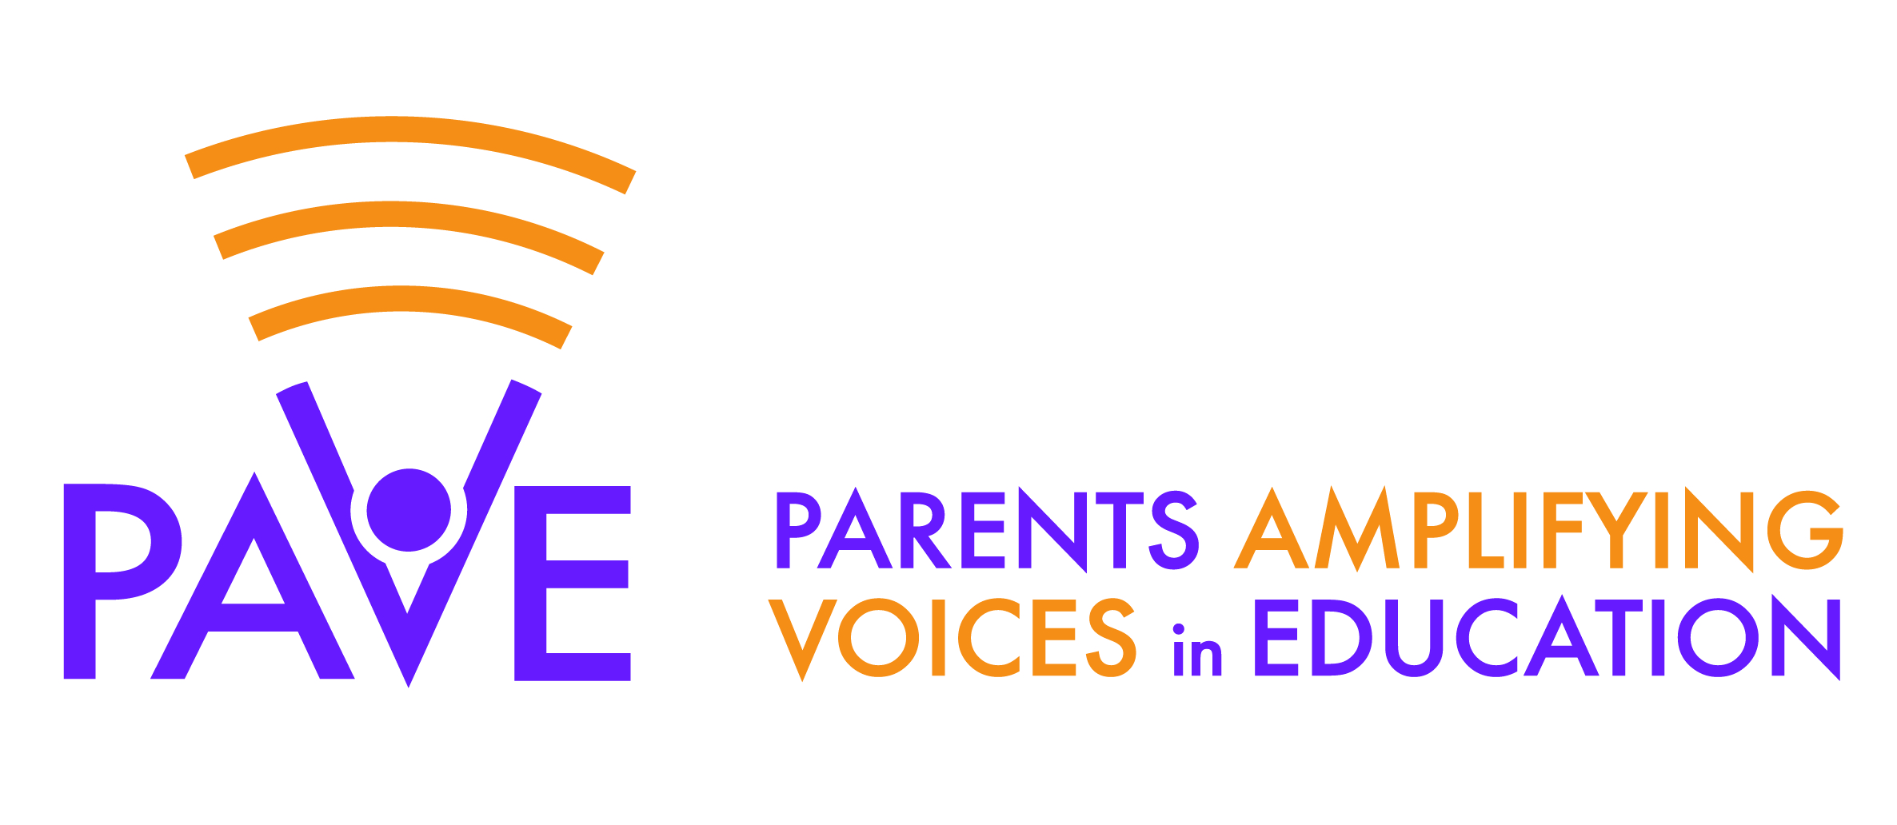
Academic Performance by Ward in DC’s Schools is Inequitable
All DC – 31%
Source: Empower12’s School Performance Overviews
Notes:
Wards 7 and 8 have the most children in the city and the most children NOT scoring at or above grade level on our state test (PARCC)

Slide 2
Some Parents Supplement School Budgets
Notes:
Parents in low poverty schools can supplement school budgets – further exacerbating inequity

Slide 3
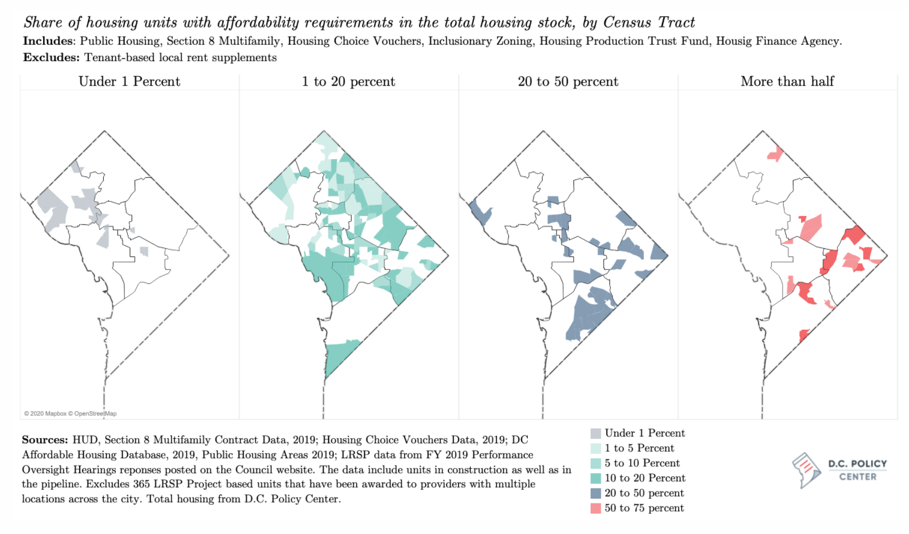
Housing in DC’s 8 Wards Is Segregated by Income (and Race)
4
4
4
4
3
1
5
3
1
5
3
1
5
3
1
5
2
2
8
2
2
6
8
6
6
8
6
8
7
7
7
7
Notes:
Most affordable housing is East of the River (Wards 7 and 8) – very little in Wards 2 and 3 – which means that our Wards are segregated by income and race since…
In DC, race and income are closely correlated

Slide 4
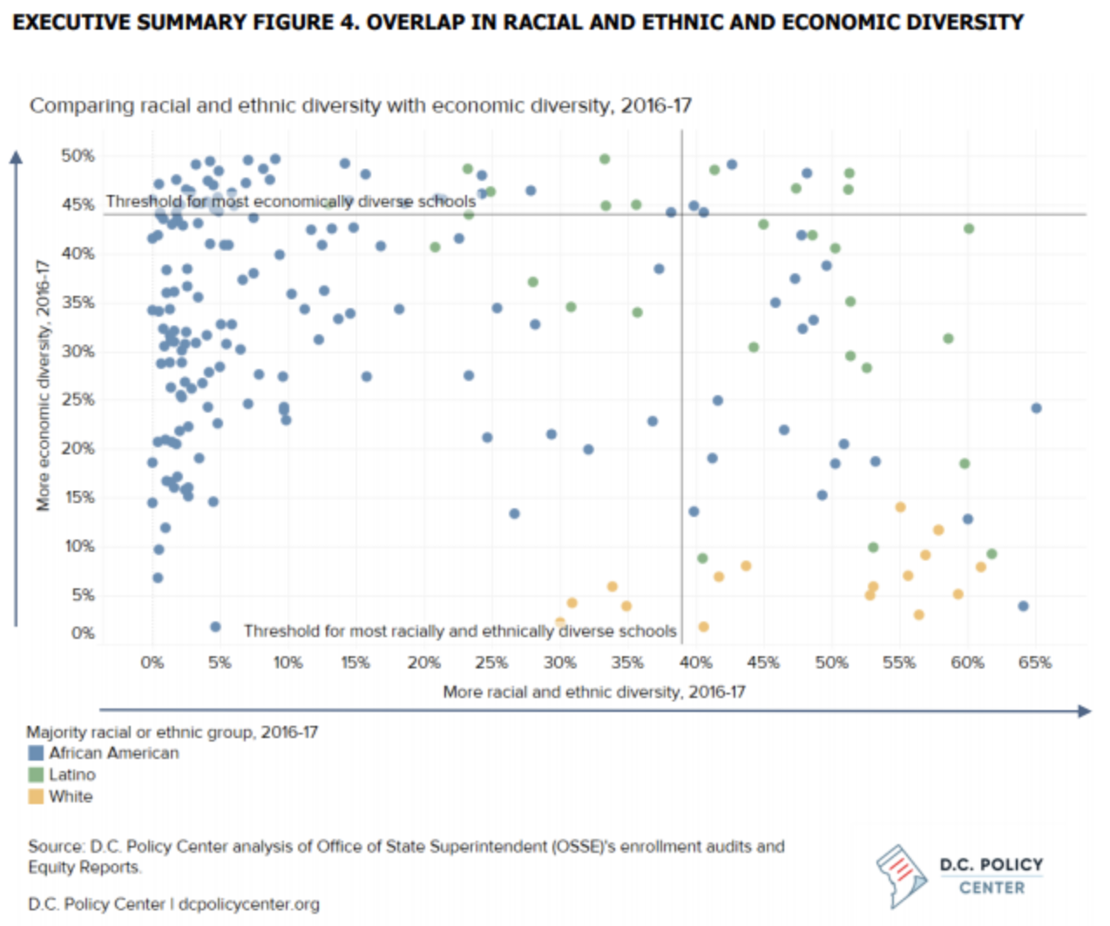
Schools in DC’s 8 Wards Are Segregated by Income and Race
Notes:
Schools in DC are also segregated by income and race
Our schools across the board in every Ward lack racial and socioeconomic diversity – few are in the area where the lines collide

Slide 5
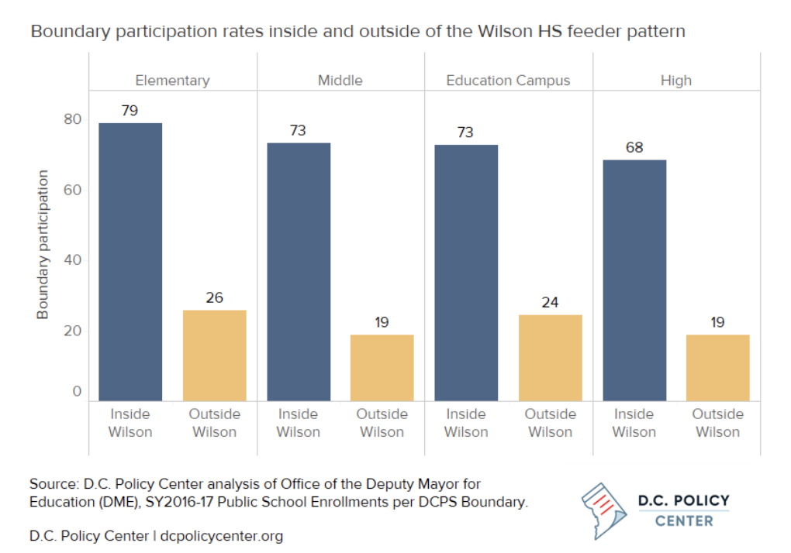
People Make CHOICES About
Where They Live AND Boundary Schools Together
“Living in a neighborhood with an elementary school that feeds into Wilson HS boosts boundary participation rates by 24 percentage points…”
Notes:
The Wilson high school feeder pattern is the strongest predictor of who choses their neighborhood schools and housing values are also higher in Wilson in-boundary neighborhoods
So people’s housing and school choices in terms of boundary schools are intertwined

Slide 6
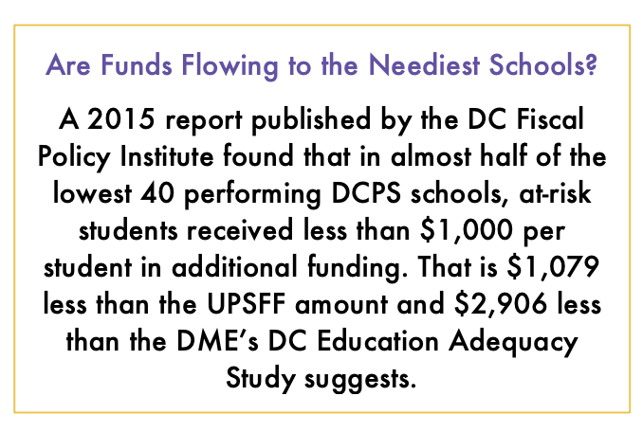
DC’s At-Risk Funding Was Created to Drive Equity
BUT…
Notes:
At-risk funding was created as an additional investment to drive equity but it’s below the city’s own adequacy study and isn’t always making it to our kids and their schools
Made small gains on the adequacy of the at-risk funds but very minimal

